Slide 1
TELECOM CUSTOMER CHURN PREDICTION
JAYANTHI T - 1817119
KIRUTHIKA S - 1817125
VARUNA PRIYA S - 1817153
YAZHINI P - 1817157
PROJECT GUIDE
Dr.R.BHAVANI AP-CSE

Slide 2
PROBLEM STATEMENT
Customer churn is the most important problem in the business world, especially in the telecommunications industry, because it greatly influences company profits. Getting new customers for a company is much more difficult and expensive than retaining existing customers.
The existence of various service providers allows customers to choose the service provider they want and have the right to switch from one service provider to another.

Slide 3
OBJECTIVE
The objective of this project is to classify Telecommunication customer will churn or non-churn using Deep Neural Network.

Slide 4
LITERATURE SURVEY
AUTHOR | TITLE | METHODOLOGY | REMARKS
Jl. Raya Margonda , Jl. Cisitu | Customer Decision Prediction Using Deep Neural Network on Telco Customer Churn Data | DNN architecture in this study uses three variations of the number of hidden layers and two variations of the activation function. | Accuracy - 82.38%
Kyungtae Kim, Jee-Hyong Lee | Bayesian Optimization of Customer Churn Predictive Model | Using the preprocessed data, customer behavior patterns are extracted with LSTM and the results are applied to FCNN to predict customer churn. | Accuracy - 76%.

Slide 5
AUTHOR | TITLE | METHODOLOGY | REMARKS
Abinash Mishra & U. Srinivasulu Reddy | A Novel Approach for Churn Prediction Using Deep Learning | A. Convolutional Neural Network (CNN)-CNN based churn prediction model consists of one input layer, one hidden layer and one output layer. | Accuray – 86.85%
Edvaldo Domingos, Blessing Ojeme , Olawande Daramola | Experimental Analysis of Hyperparameters for Deep Learning-Based Churn Prediction in the Banking Sector | The experiments were performed on both the DNN and MLP churn models by changing the activation functions that were used in the hidden layers and the output layer. | DNN Accuracy - 86.9% MLP Accuracy - 83.85%

Slide 6
METHODOLOGY
The proposed system consists of five main modules
Dataset collection
EDA Analysis
Dataset Pre-processing
Train the DNN model
Classify the dataset as Churn or Not churn

Slide 7
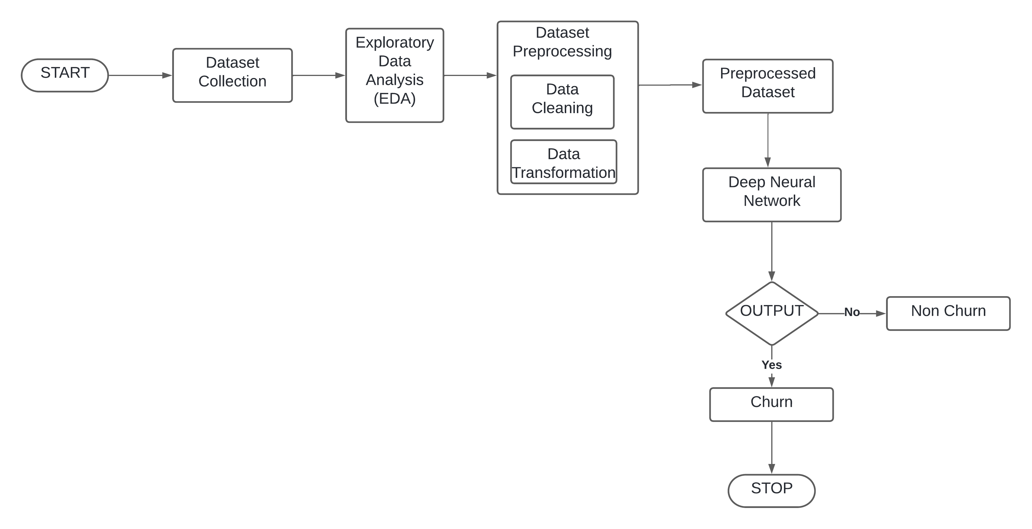
FLOWCHART

Slide 8
DATASET COLLECTION
The dataset used in this project is a collection of IBM telecommunications data downloaded from a public repository.
Contains about 7043 rows and 21 columns in which each row represents customer and each column represents the customer’s attribute.
There are about 73.4 % of non-churn customer data and 26.6 % of churn customer data in the dataset.

Slide 9
EXPLORATORY DATA ANALYSIS(EDA)
EDA is the process of investigating the dataset to discover patterns, and anomalies (outliers), and form hypotheses based on our understanding of the dataset.
After analysing our dataset using EDA, the outcomes observed are
1) For Gender, the churn percent is almost equal in case of Male and Females. The percent of churn is higher in case of senior citizens.Customers with Partners and Dependents have lower churn rate.
2) A larger percent of Customers with monthly subscription have left when compared to Customers with one or two year contract. Churn percent is higher in case of customers having paperless billing option.

Slide 10
DATA PRE-PROCESSING
Data Cleaning:
Check and delete data related to missing data values, the aim is to avoid data anomalies at the next stage.
In the collected dataset, there are 11 missing data values in the total charges attribute. So it is deleted.
Data Transformation:
This stage is done by using one-hot encoding. The transformation process on the dataset used is using the pandas' library with the get dummies method.

Slide 11
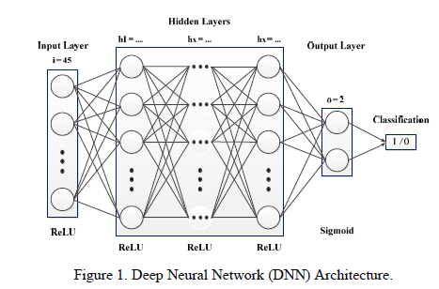
DEEP NEURAL NETWORK(DNN)
The three layers of the DNN consist of the input layer, which is the input data layer, the hidden layer receives data from the input layer to be processed in the DNN. In the output layer, the output nodes are binary, resulting in classification decisions.

Slide 12
The DNN architecture in this project uses three hidden layers and two variations of the activation function.
Each hidden layer uses the rectified linear unit (ReLu) activation function, and in contrast, the output layer uses the Sigmoid activation function.
During the training process, optimizer is added manually.
The number of nodes in the output layer is the number of classes contained in the dataset as churn and non-churn.

Slide 13
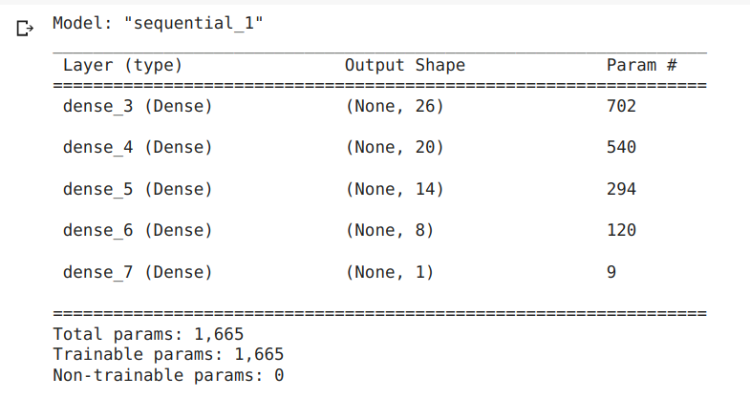
MODEL SUMMARY

Slide 14
THANK YOU

